Slide 1

Space, Range & Display- Supported Plans Matrix
Somnath Bardhan
December 2006
Notes:
1

Slide 2
What is Supported Plans Matrix
Supported Plans Matrix is a representation of the planned space for a display group and associating this with the supported space using range classes
It is accountable for all store clusters and equipment types relevant for a specific display group
The Equipment matrix generated will be used by the ranging system (Assort) for Cluster Ranging and defining the supported space breaks

Slide 3
Familiarization with the Space terms
Actual space: The physical space in store
Current Space: Space recorded within the computer system by the store for the current date
Non-Trading Current Space: Space recorded for a new store that has not yet opened (i.e. the space is not yet effective)
Space Recommendation : Ideal space for a display group in-store based on the format plan, space rules and sales
Target space: Achievable space for a display group in store, based on the space recommendation but tailored according to the specific layout of the store (e.g. pillars / wrapping around etc) and which space breaks are supported. This target will be valid for a period of time.
Planned Space :A change to the target space. This is valid for a date in the future and should be implemented by the store on that date.
Store-planned space :A change to the amount of space allocated to a display group that the store intends to make on a future date.

Slide 4
Triggers for Supported Plans Matrix
Scheduled Ranging Event: This process is carried out by the Space team, for any event on the Space, Range and Merchandising Schedule that requires a change to stores’ Target Space. The process starts around 20 weeks before the effective date of the event
Business expansion work: This occurs when the natural works team decides for the need for opening a new store, for an extension or for a refit to an existing store. The process starts 8 weeks before the effective date of the UKBE change
Store plans to change the fixture for the display group: This process will be carried out by a store, on an ad hoc basis, whenever the store decides to review the assignment of ‘matched’ Display groups to space within the store.
Store requests for a change in their target space:Stores will carry out this process whenever a change is required to the Space Target for a particular store. This might be to enable the store to start stocking a Display group, stop stocking a Display group

Slide 5
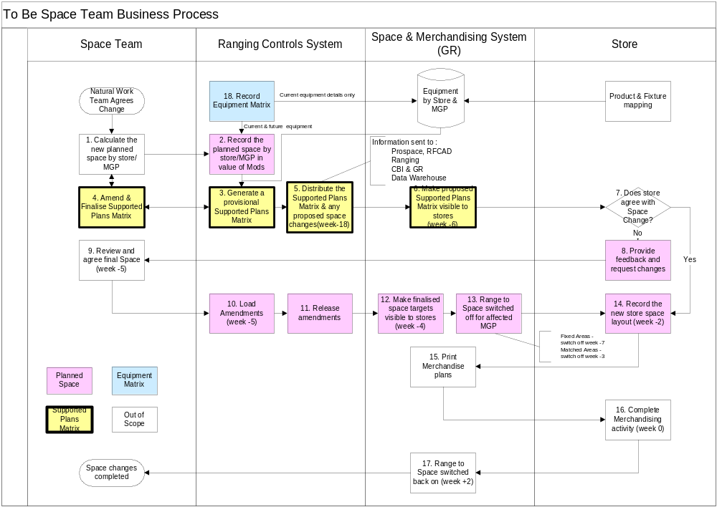
Process Flow

Slide 6
System Flow for generating the matrix
Select Range Id
Select Cluster
Assign Space Break
Assign no of Mods
Assign Equipment Type
Assign no of stores

Slide 7
Parameters for an equipment Matrix
Equipment matrix
Equipment type
Equipment Dims
Equipment name
Equipment Dimensions (H-W-D)
CRDB
GR

Slide 8
Space matrix Analogy
Range Class
METRO |  | A | B | C | D
 | MOD | 1 | 2 | 3 | 4
 | MDD | 19 | 27 | 35 | 4
 | LFD | 3 | 7 | 9 | 1
Value of Mods for each Range Class
Cluster name
Equipment Type
No of stores for each equip type

Slide 9
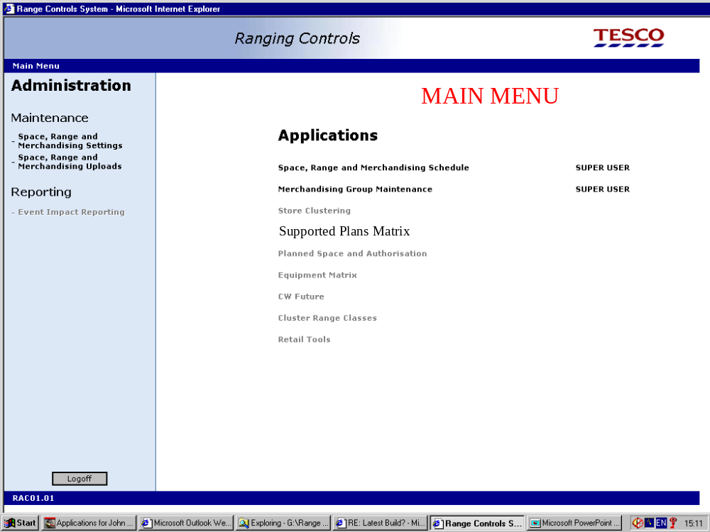
Screenshots

Slide 10
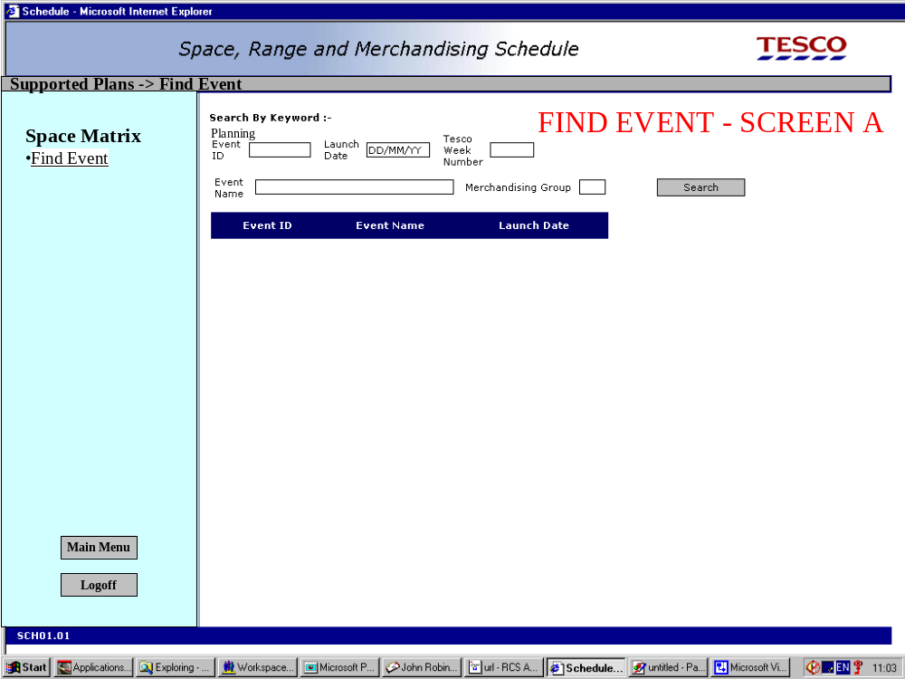
Screenshots

Slide 11
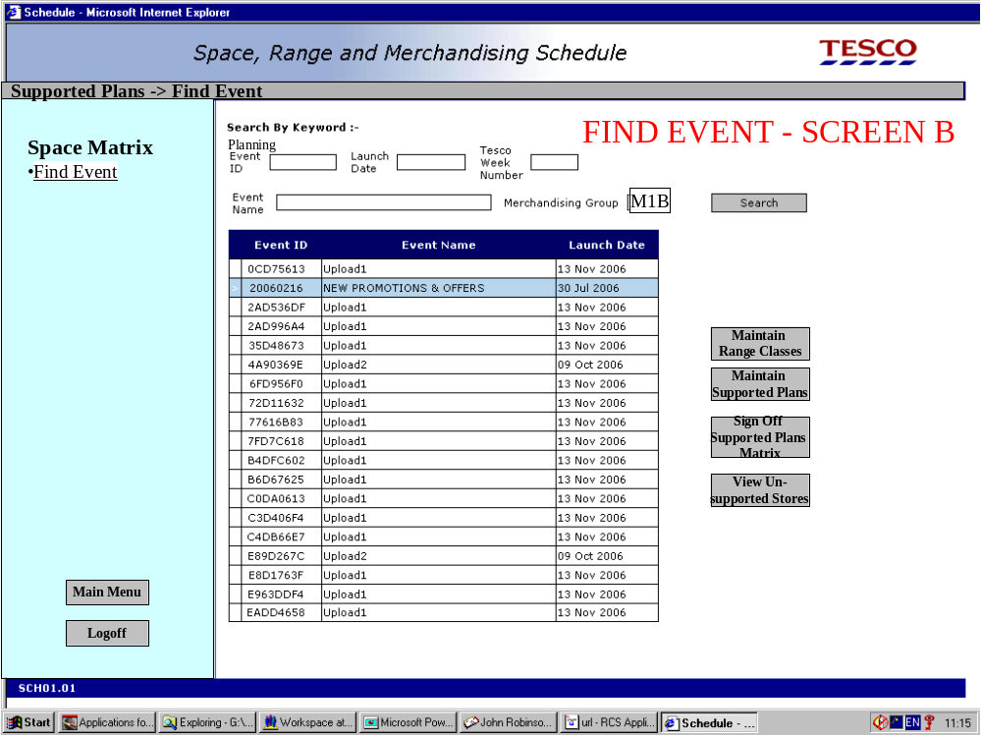
Screenshots

Slide 12
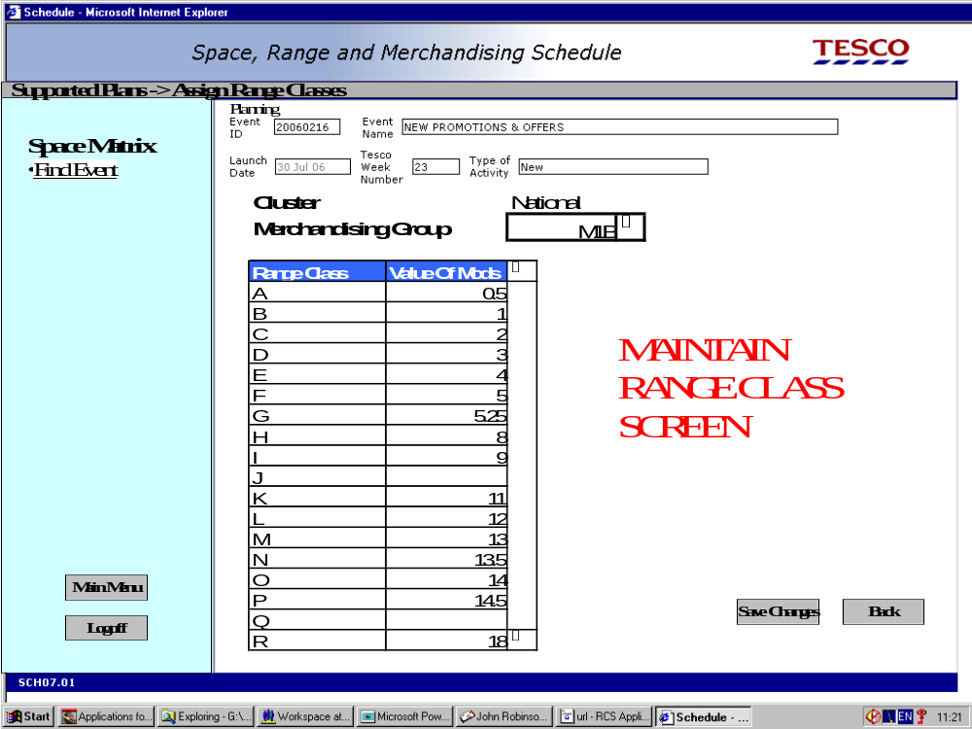
Screenshots

Slide 13
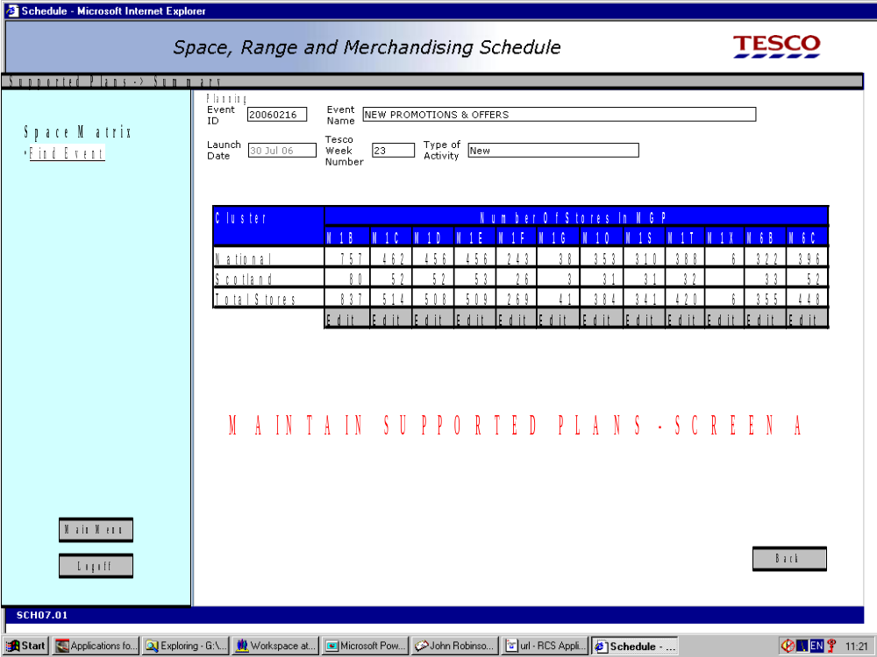
Screenshots

Slide 14
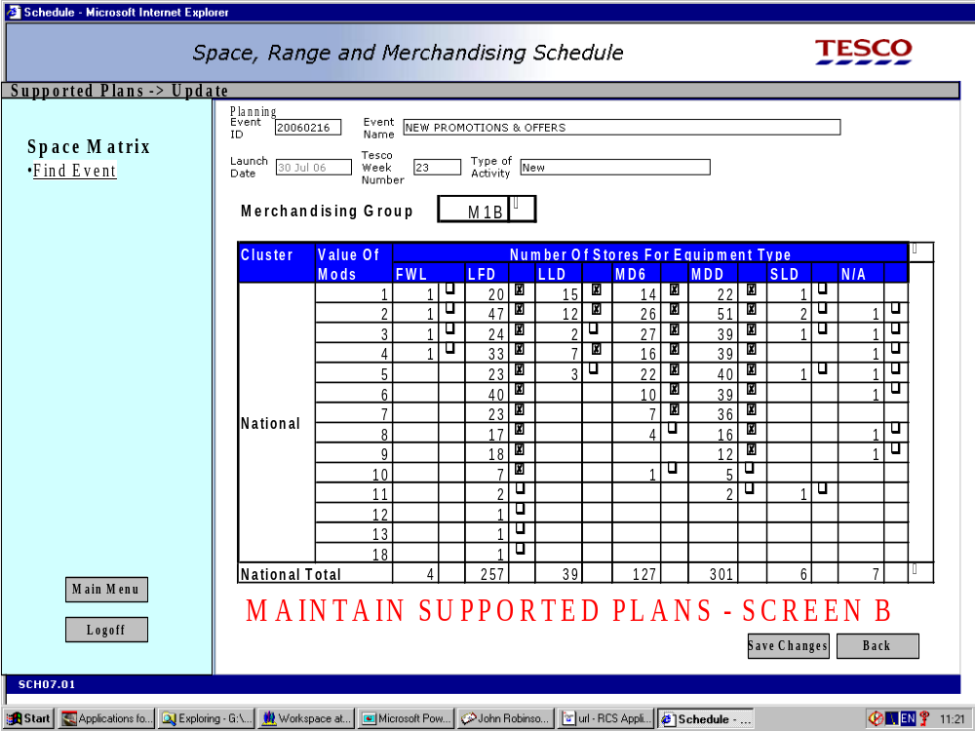
Screenshots

Slide 15
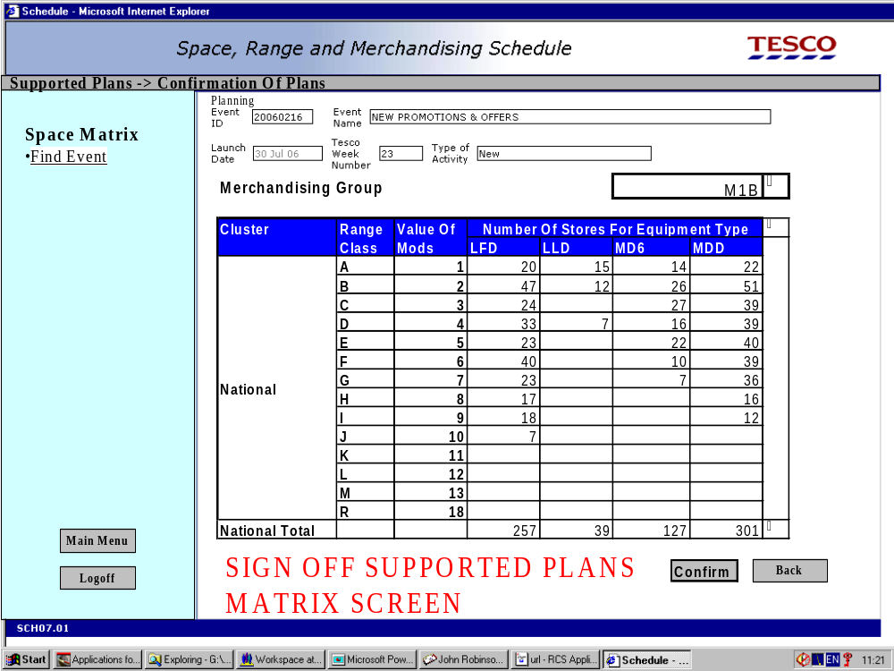
Screenshots

Slide 16
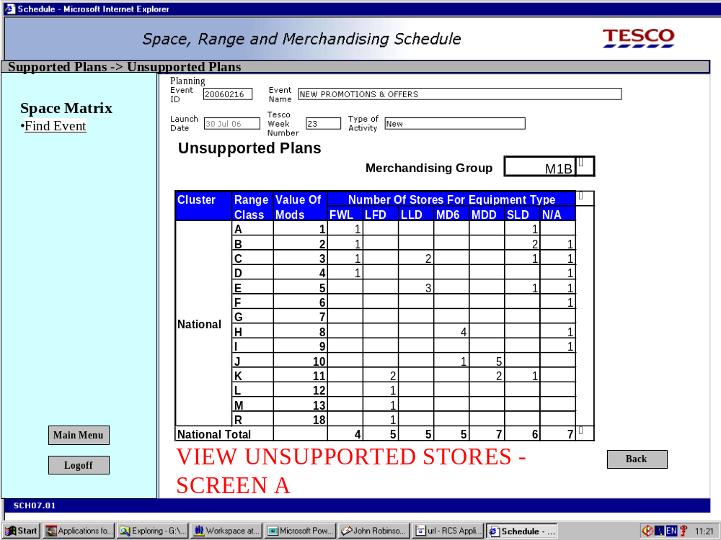
Screenshots

Slide 17
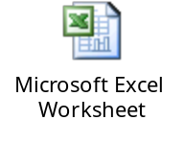
Summary
What is Supported Plans Matrix
What are the various triggers for generating Supported Plans Matrix
What is the process flow involved in Supported Plans Matrix
Screen level Overview of the functionality

Slide 18
Questions

